Slide 2
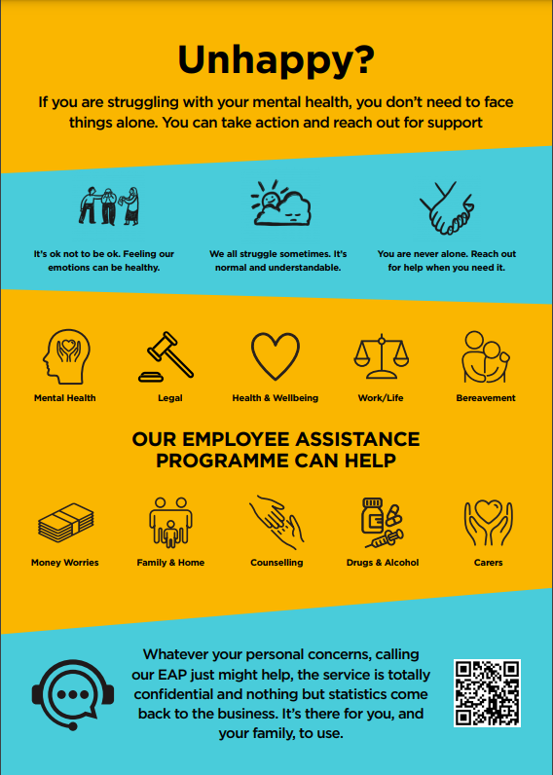

Slide 3
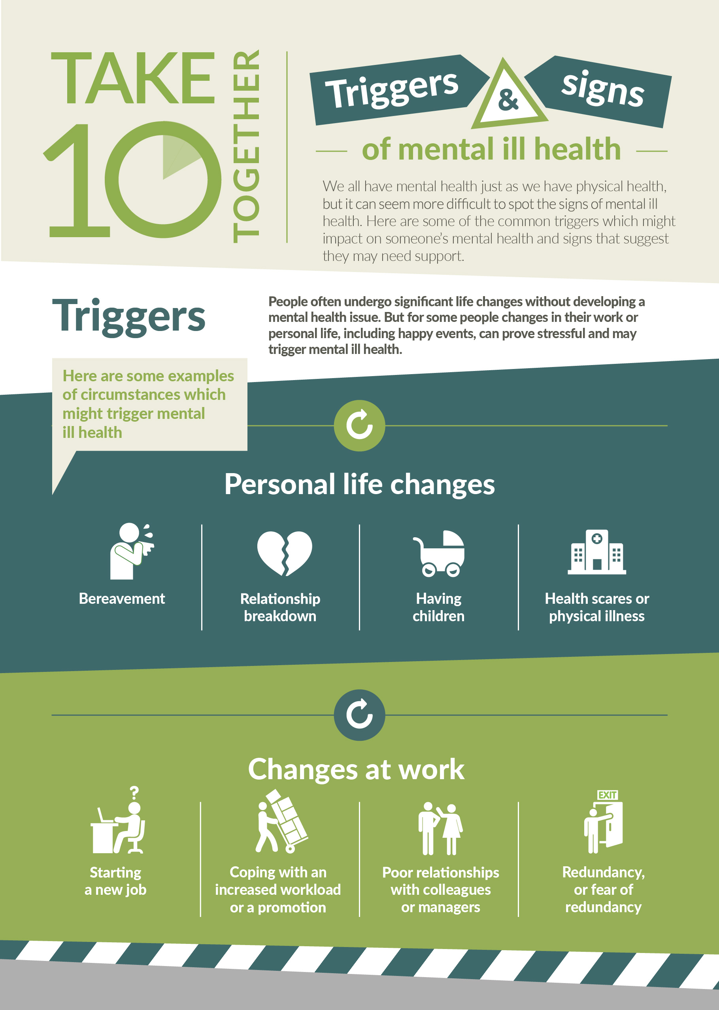

Slide 4
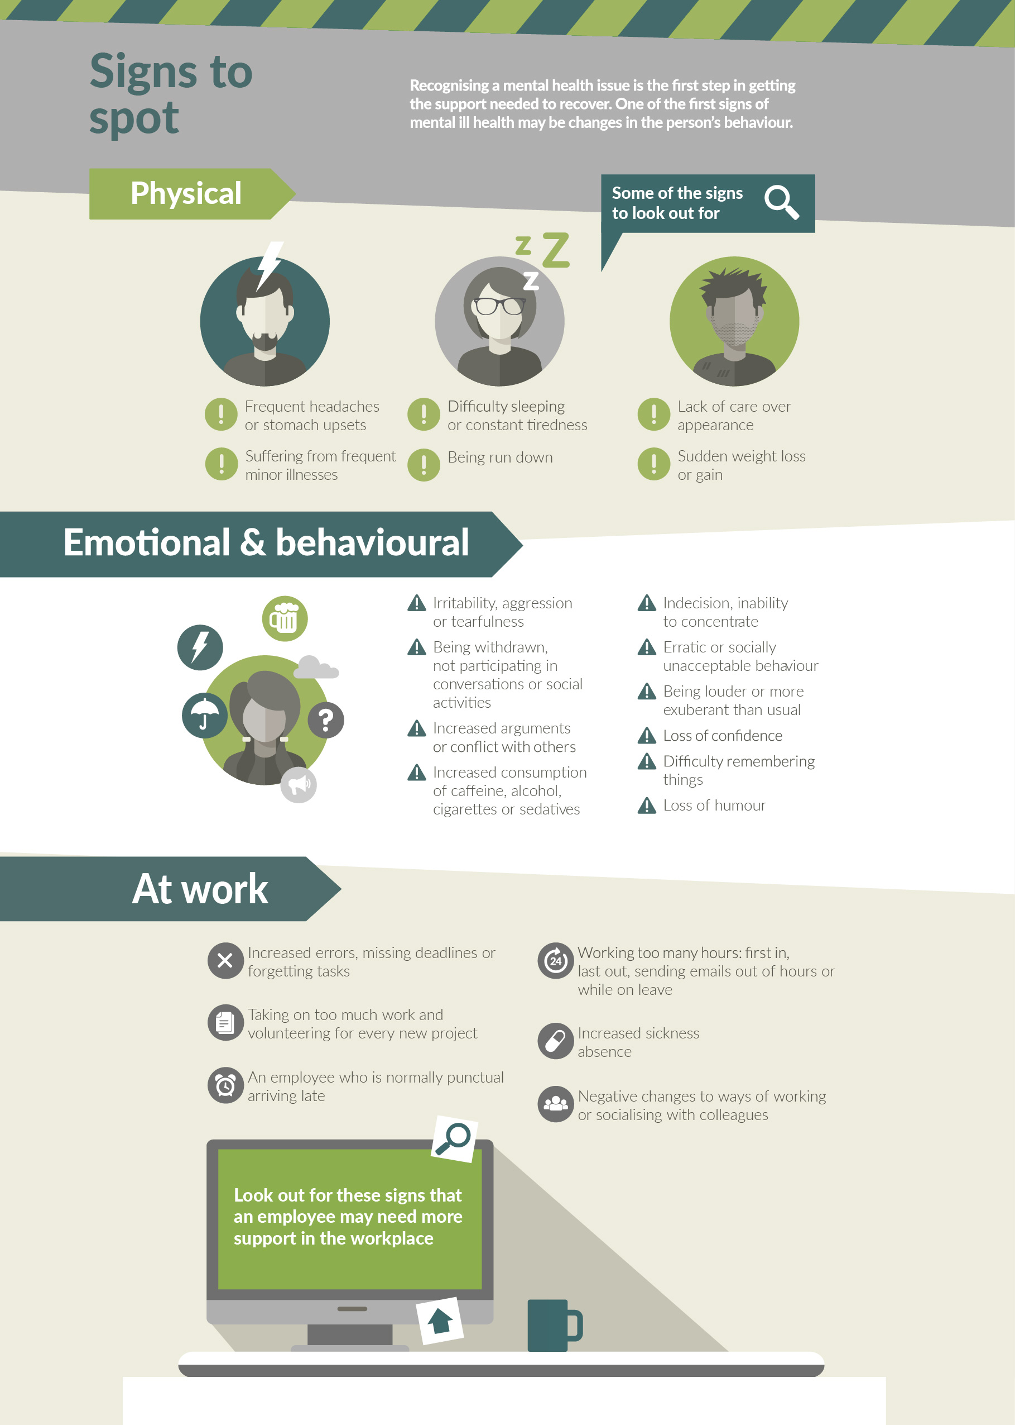

Slide 5
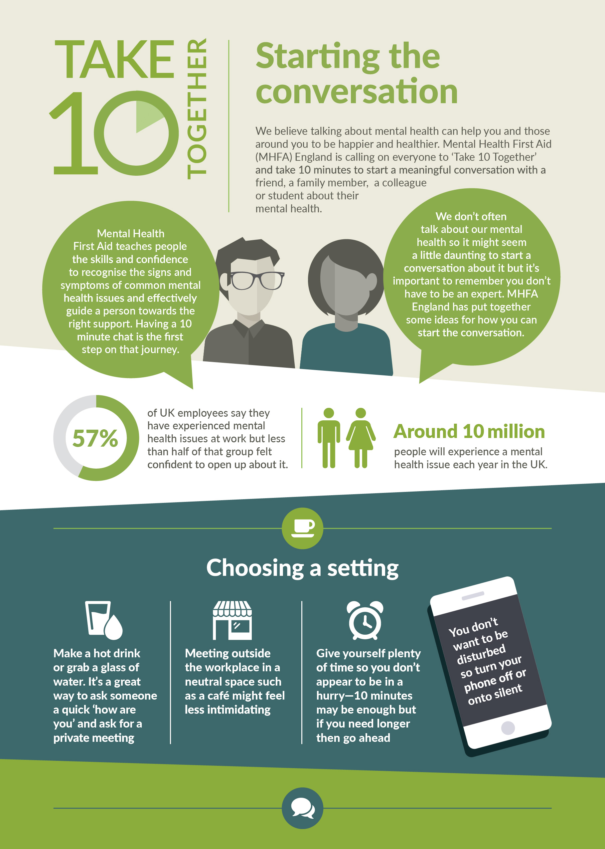

Slide 6
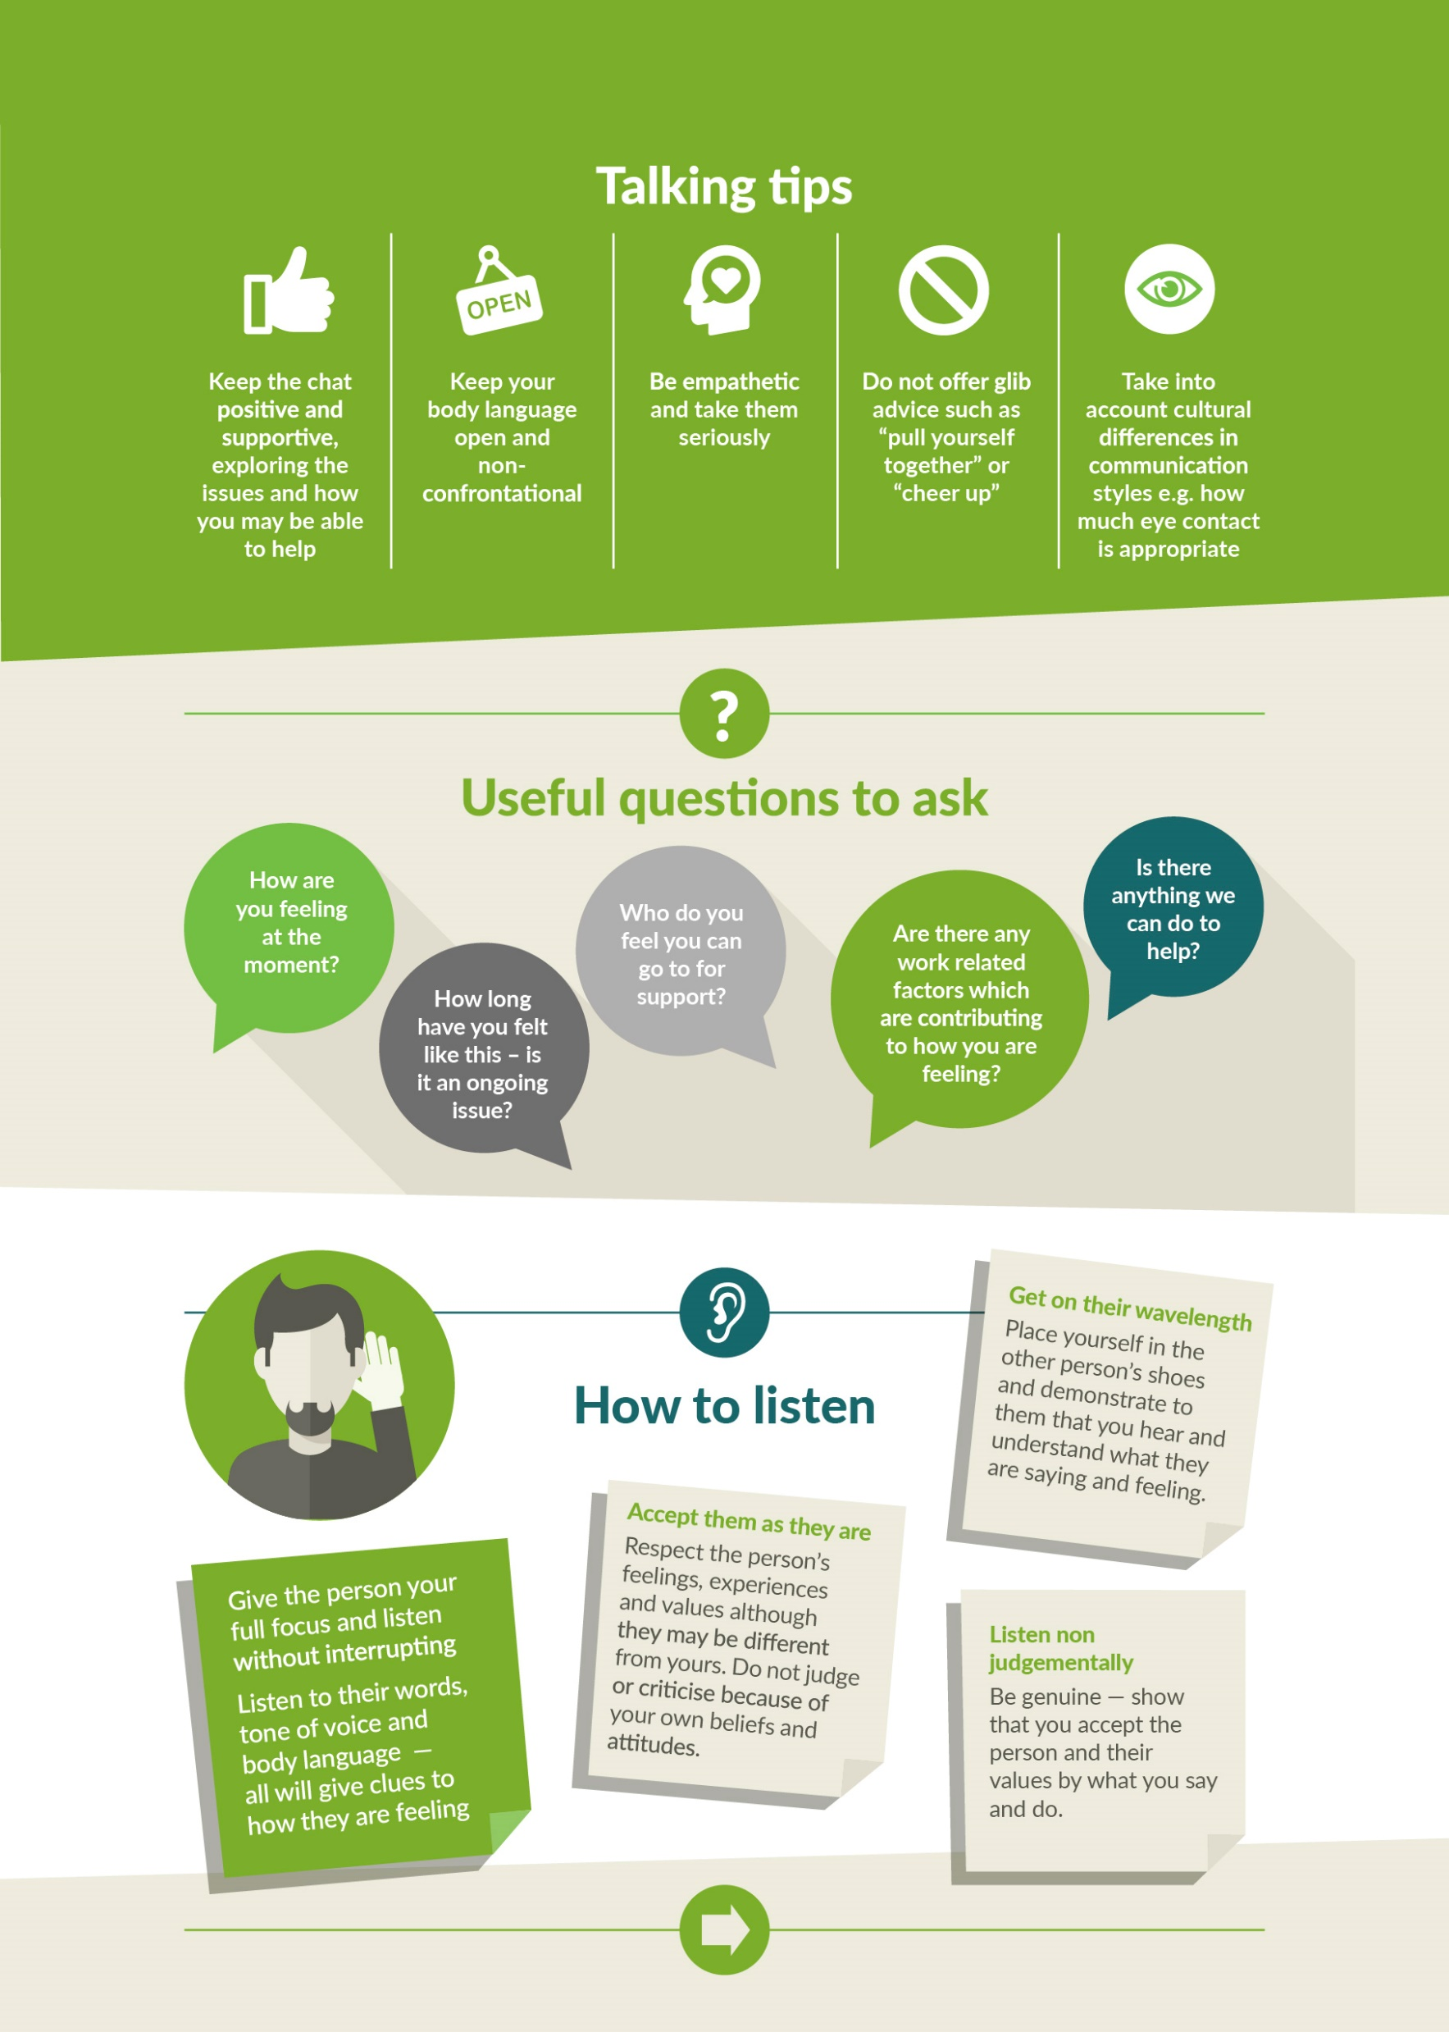

Slide 7
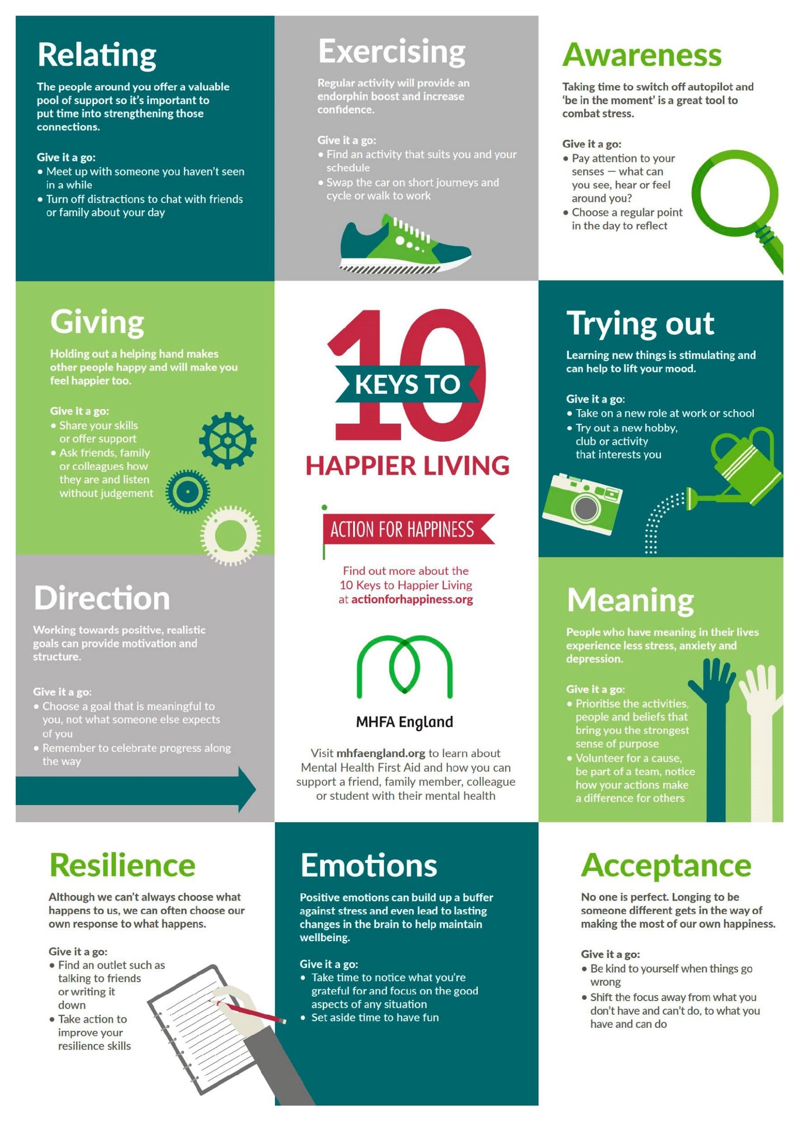

Slide 8
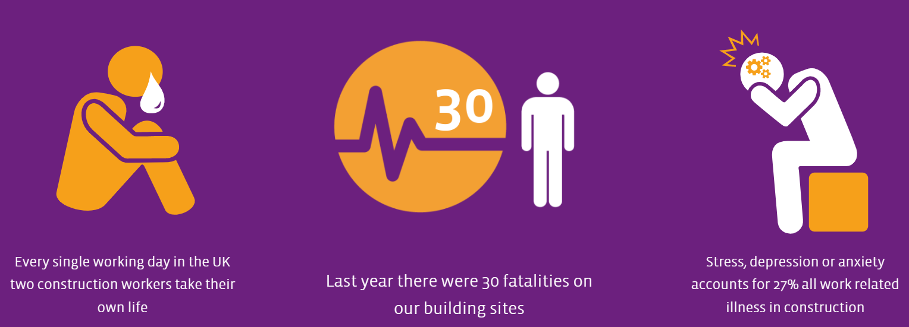
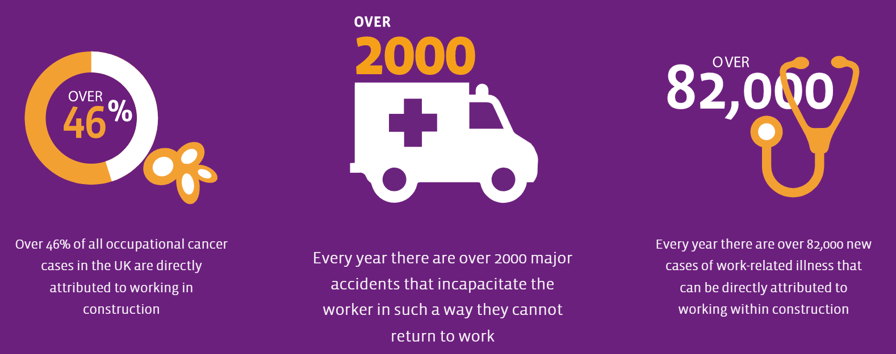

Slide 9
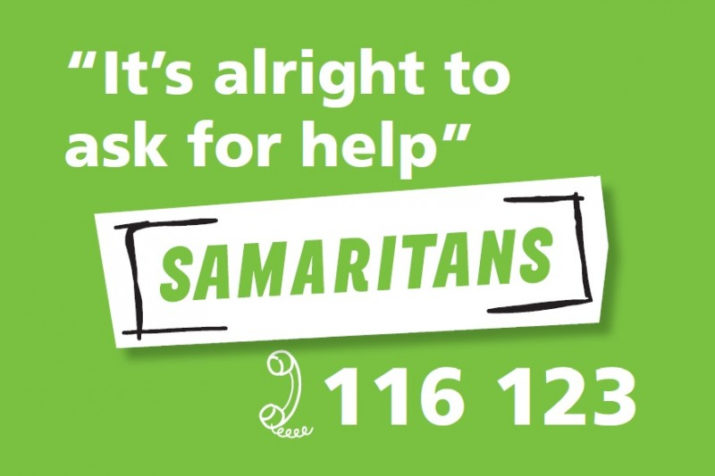

Slide 10
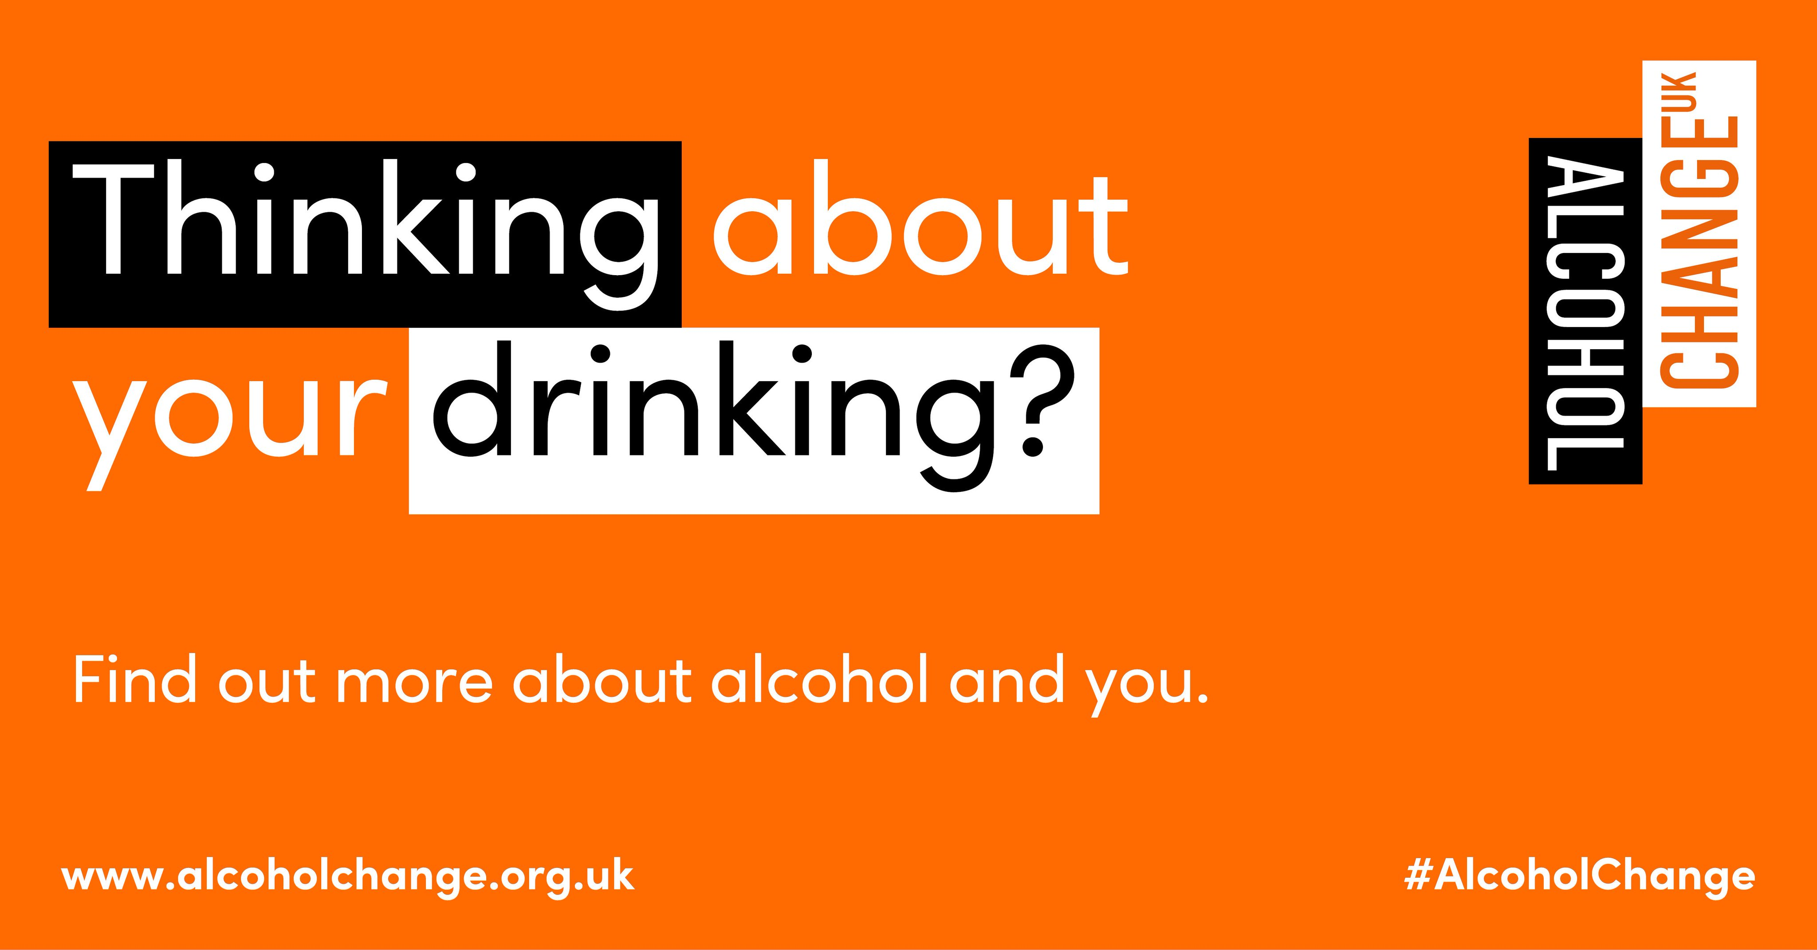
Drinkline is a free, confidential helpline for people who are concerned about their drinking, or someone else's. Call 0300 123 1110 (weekdays 9am–8pm, weekends 11am–4pm)

Slide 11
Available 24 hours a day, 7 days a week. The National Gambling Helpline is operated by GamCare.
Call 0808 8020 133

Slide 12
https://www.themenopausecharity.org/

